Slide 1
C# & .NET Framework
Chapter 3: C# Fundamental
Chapter 4: OOP with C# 2.0
Chapter 5: Object Lifetime
Chapter 6: Exception Handling

Slide 2
Chapter 1: Review
.NET base class libraries
.NET Assemblies
Assembly Metadata and Manifest
Common Intermediate Language (CIL)
Common Type System (CTS)
Common Language Specification (CLS)
Common Language Runtime (CLR)

Slide 3
Chapter 2: Review
Building C# application by command-line:
Building C# applications using VS 2005
Code Definition View: Allow quickly accessing to other class without closing (or hiding) the current class window
Code Refactoring: extract method, surround with, snippets
Visual Class Designer
Object Test Bench
csc /target:exe HelloMsg.cs [/out “file name”]

Slide 4
Chapter 3: Objectives
The Anatomy of a Simple C# Program.
Classes and Objects
Establishing Member Visibility
Defining Constant Data
Defining Read-Only Fields.
The static Keyword
Method Parameter Modifiers
Iteration Constructs
Understanding Value Types and Reference Types
Boxing and Unboxing Operations
The Master Class: System.Object

Slide 5
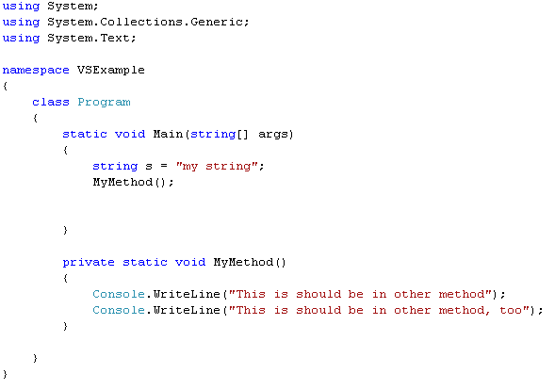
Structure of a C# program
Referencing namespace
Namespace of the current class
Entry point: main()
C# is a case-sensitive programming language

Slide 6
Structure of a C# program
Variations on the Main() Method
// No return type, array of strings as argument.
public static void Main(string[] args) { }
// No return type, no arguments.
public static void Main() { }
// Integer return type, no arguments.
public static int Main() { }

Slide 7
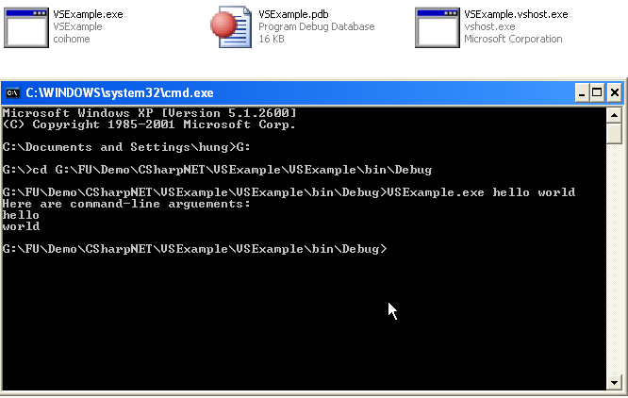
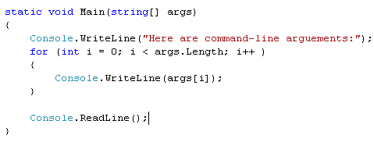
Structure of a C# program
Command-line arguments

Slide 8
Classes and Objects
A class is a definition for a user-defined type (UDT)
An object is a given instance of a particular class in memory
In C#, the new keyword is used to create an object.
Ex: ClassA A1 = new ClassA();
Every C# class is automatically provided with a free default constructor

Slide 9
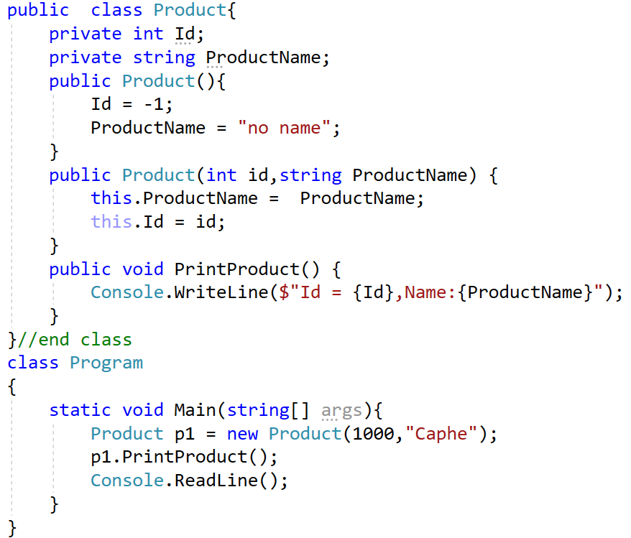

Slide 10
Member Visibility
C# access modifier | Description
public | Accessible from an object variable as well as any derived classes
private | Accessible only by the class that has defined the method. In C#, all members are private by default.
protected | Marks a method as usable by the defining class, as well as any derived classes. Protected methods, however, are not accessible from an object variable.
internal | The same assembly, but not outside the assembly.
protected internal | Access is limited to the current assembly or types derived from the defining class in the current assembly
Types (classes, interfaces, structures, enumerations, and delegates)
are limited to public or internal (default).

Slide 11
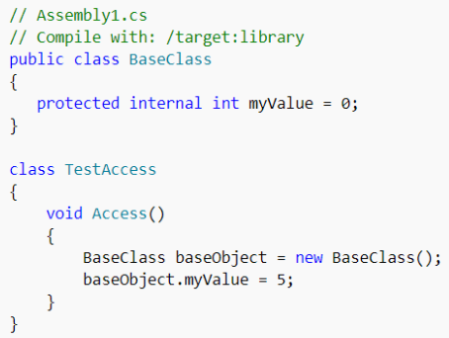
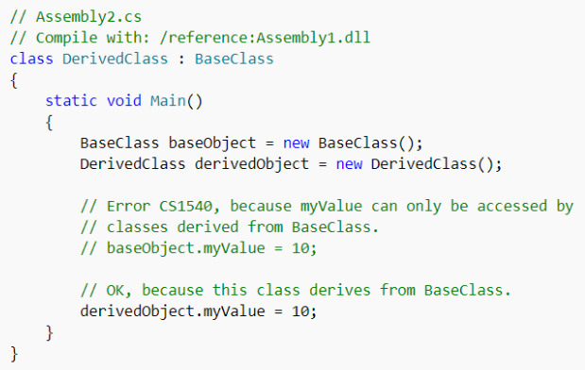

Slide 12
Defining Constant Data
C# offers the const keyword to define variables with a fixed, unalterable value.
It is important to understand that the value assigned to a constant variable must be known at compile time => constant member cannot be assigned to an object reference
All constant fields are implicitly static
Ex: public const string MyConstant = "Timberwolves";

Slide 13
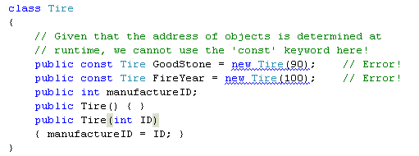
Defining Constant Data
Example:
Cannot declare reference type as constant

Slide 14
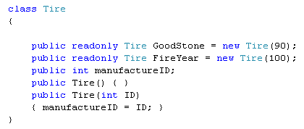
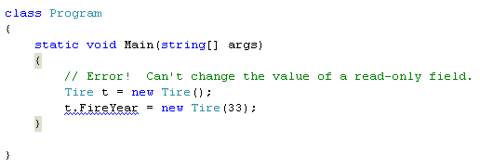
Defining Read-Only Fields
Read-only fields allow you to establish a point of data whose value is not known at compile time, but that should never change once established.
Read-only fields are not implicitly static
Cannot change the value of read-only field

Slide 15
Static Constructor
Prevent static field to be reset
A given class (or structure) may define only a single static constructor
A static constructor executes exactly one time, regardless of how many objects of the type are created
A static constructor does not take an access modifier and cannot take any parameters
The static constructor executes before any instance-level constructors

Slide 16
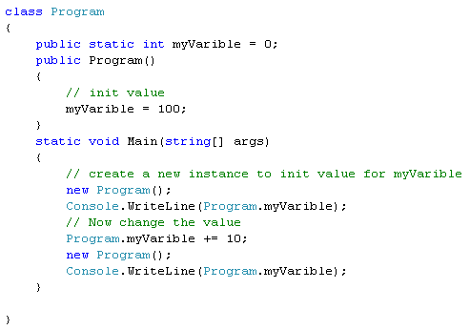
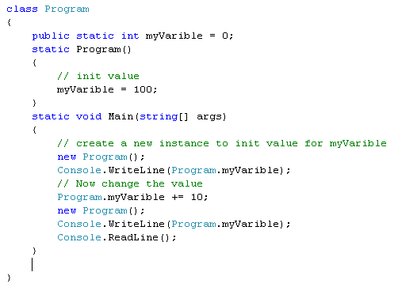

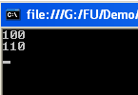
Static Constructor
Example 01
output

Slide 17
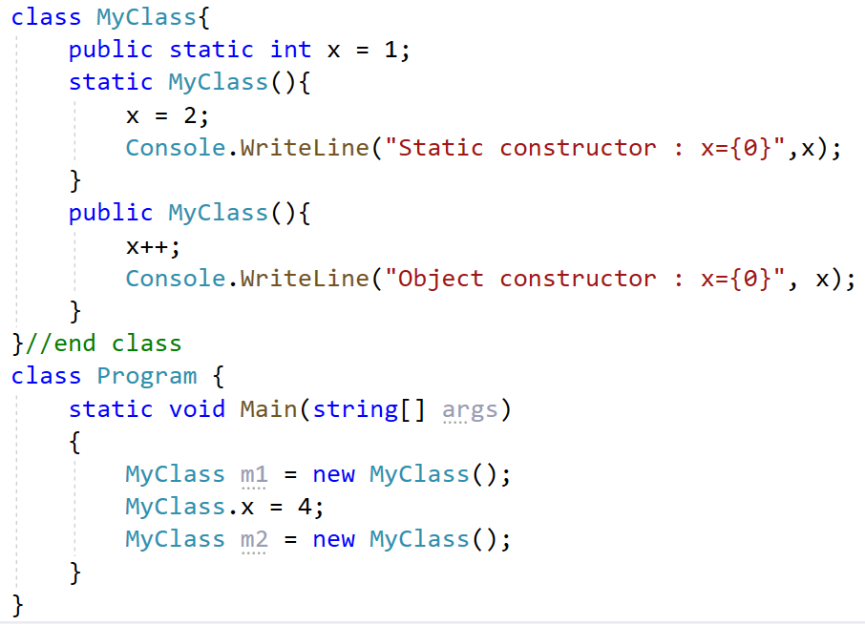

Static Constructor
Example 02

Slide 18
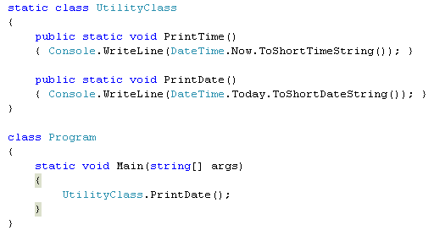
Static Class
Static class cannot be created using the new keyword
Static class can contain only static members or fields
No instance created

Slide 19
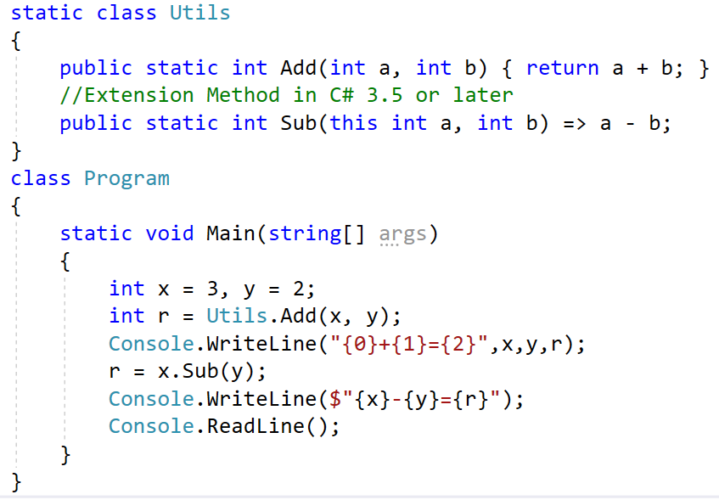
Static Class

Slide 20
Method Parameter Modifiers
Parameter Modifier | Description
(none) | Parameters are passed by value
out | Output parameters are assigned by the method being called (and therefore passed by reference).
params | Allows having a number of identically typed arguments as a single logical parameter. A method can have only a single params modifier, and it must be the final parameter of the method.
ref | Parameters are passed by reference.

Slide 21
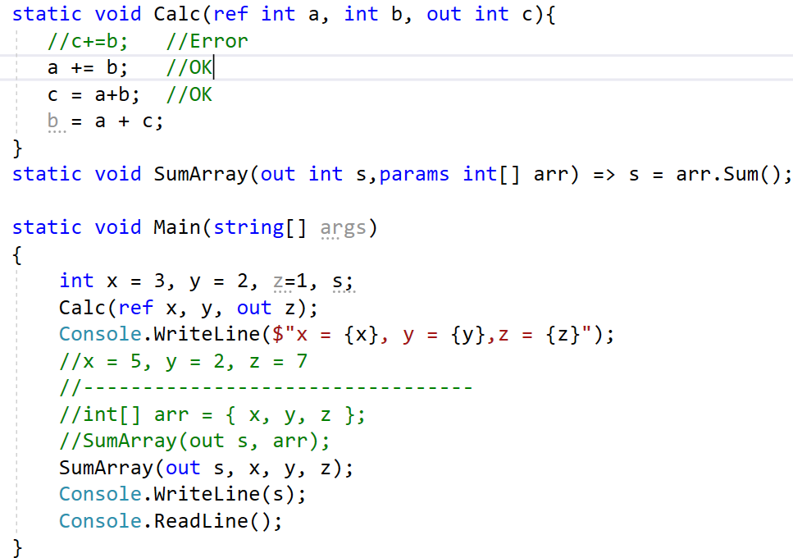

Slide 22
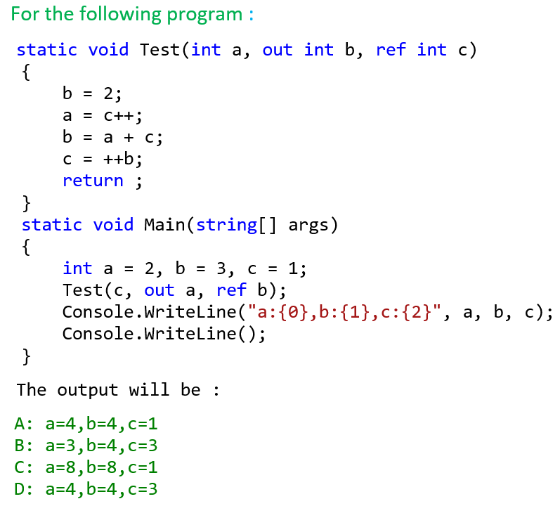

Slide 23
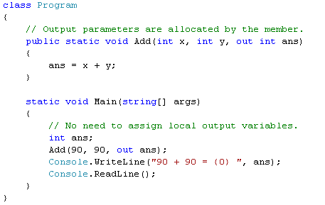
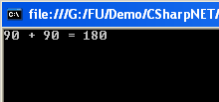
Method Parameter Modifiers
The out Modifier
Notes:
The out keyword causes arguments to be passed by reference. This is similar to the ref keyword, except that ref requires that the variable be initialized before being passed. To use an out parameter, both the method definition and the calling method must explicitly use the out keyword.
For more: http://msdn.microsoft.com/en-us/library/t3c3bfhx(VS.80).aspx

Slide 24
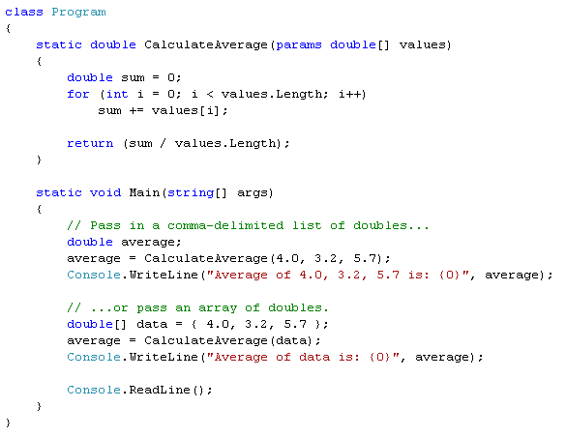

Method Parameter Modifiers
The params Modifier

Slide 25
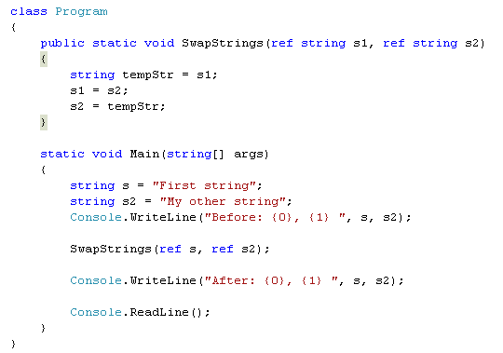

Method Parameter Modifiers
The ref Modifier
Local variable must be assigned value before any use

Slide 26
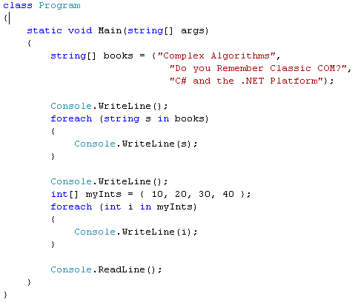
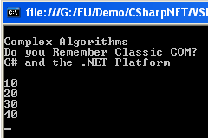
Iteration Constructs
for loop
foreach/in loop
while loop
do/while loop

Slide 27
Value Types and Reference Types
Value-based types, which include all numerical data types (int, float, etc.), as well as enumerations and structures, are allocated on the stack
value types can be quickly removed from memory once they fall out of the defining scope
In contrast, reference types (classes) are allocated on the managed heap
these objects stay in memory until the .NET garbage collector destroys them

Slide 28
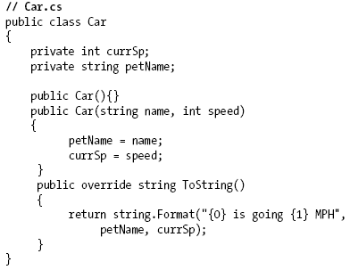
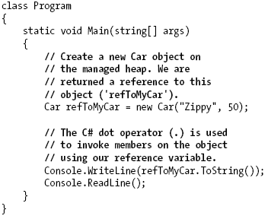
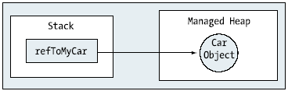
Value Types and Reference Types
No garbage collector in stack
Garbage collector is performed here

Slide 29


Boxing and Unboxing Operations
Boxing: converting a value type into a corresponding reference type by storing the variable in a System.Object.
Unboxing: converting the value held in the object reference back into a corresponding value type.

Slide 30
System.Object
Every type is ultimately derived from a common base class: System.Object
When you create a class that does not explicitly specify its base class, you implicitly derive from System.Object

Slide 31
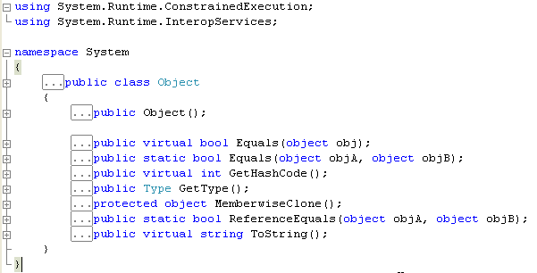
System.Object
Object class’s methods
We usually override these methods

Slide 32
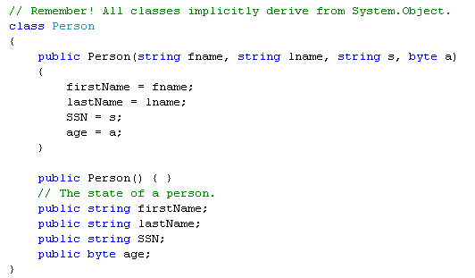
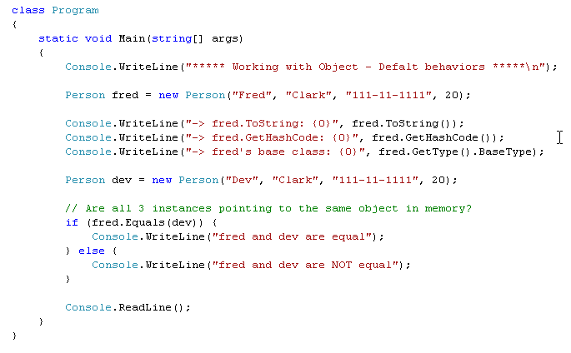
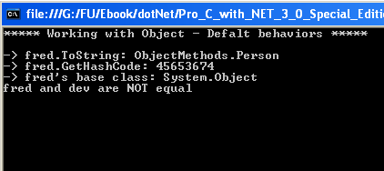
System.Object: default behaviors

Slide 33
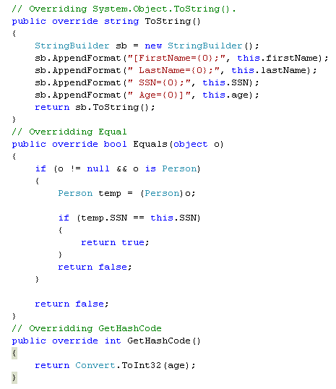
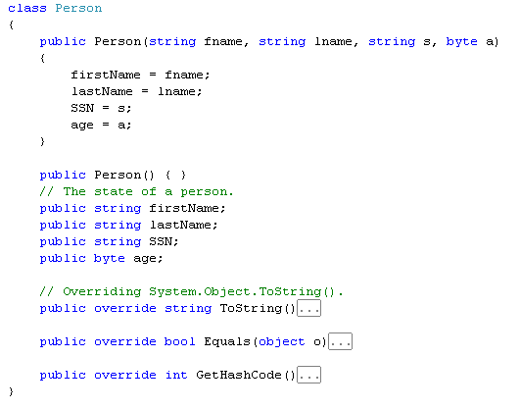
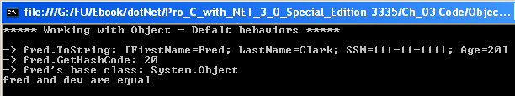
System.Object: overridden behaviors
Main() method likes
the previous slide

Slide 34
Chapter 3: Summary
Member visibility: public, private, protected, internal, protected internal
Types (classes, interfaces, structures, enumerations, and delegates) are limited to public or internal (default).
All constant fields are implicitly static
Read-only fields are not implicitly static
Static constructor
Method parameter modifiers: out, prams, ref
Value types & reference types
Boxing & un-boxing
System.Object: toString(), equal()

Slide 35
Chapter 3: Q & A

Slide 36
C# & .NET Framework
Chapter 4: OOP with C# 2.0

Slide 37
Chapter 4: Objectives
Reviewing OOP Concepts.
OOP - Encapsulation.
OOP - Inheritance.
OOP - Polymorphism.
C# Casting Rules
Partial Types

Slide 38
OOP Paradigm
Procedure-Oriented Program
Class A
{
}
data1
Modifiers
data1
data2
Function1 ()
Function1 (data1)
Function2 ()
Function2 (data1)
Function3 (data2)
Function4 (data2)
Class B
{
}
Object = Data + Methods
data2
Modifiers
Function3 ()
Basic Concepts
Encapsulation
Inheritance
Polymorphism
Particular methods:
Constructors
Function4()

Slide 39
OOP - Encapsulation
Aggregation of data and behavior:
Data of a class should be hidden from the outside.
All data should be accessed only via methods.
A method should have a boundary condition (a limit on the range of arguments for which a method ca operate properly).
Ex: a square-root cannot operate on a negative number

Slide 40
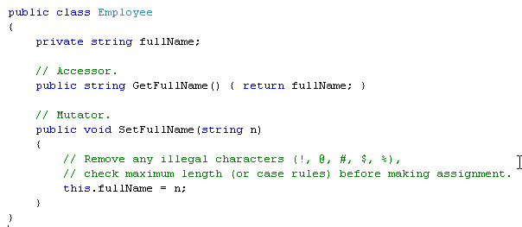
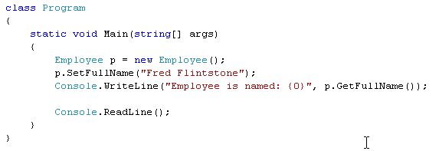
OOP - Encapsulation
Using traditional accessor and mutator
accessor
Mutator

Slide 41
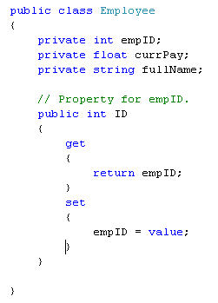
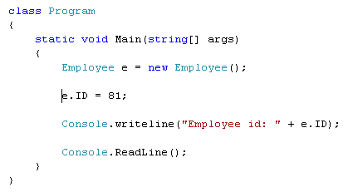
OOP - Encapsulation
Using Properties
the C# value token is not a keyword,
but rather a contextual keyword

Slide 42
OOP - Inheritance
Ability allows a class having members of an existed class ➔ Re-used code.
class PERSON
class STUDENT
ID_Num
Name
YearOfBirth
Address
getID_Num()
setID_Num(newID)
......
ID_Num
Name
YearOfBirth
Address
getID_Num()
setID_Num(newID)
......
inherited
“is a” relationship
extensions
RollNum
Score
getScore()
setSore(newScore)
......
class STUDENT
RollNum
Score
getScore()
setSore(newScore)
......
Son = Father + extensions

Slide 43
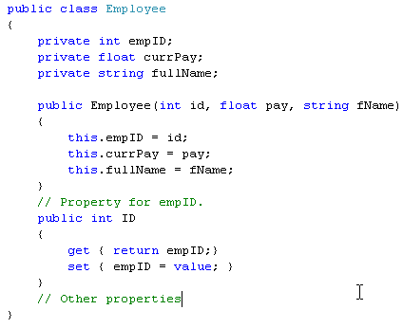
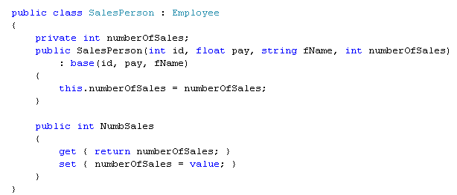
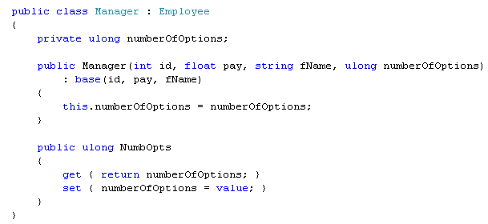
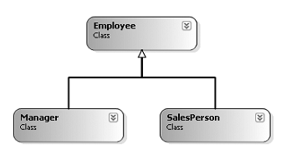
Inheritance Implementation in C#
Invoke parent’s constructor
Invoke parent’s constructor

Slide 44
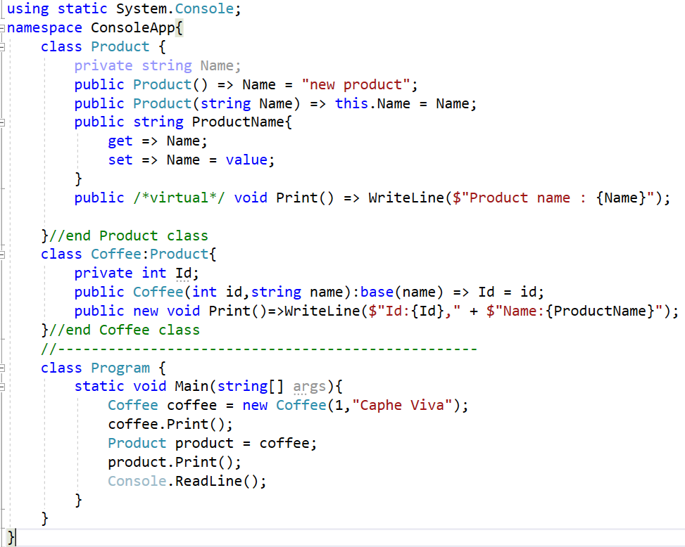

Slide 45
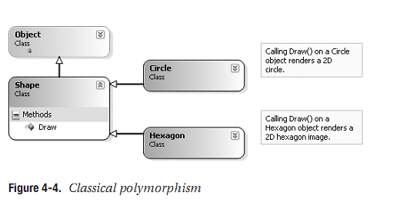
OOP - Polymorphism
Ability allows many versions of a method based on overloading and overriding methods techniques.

Slide 46
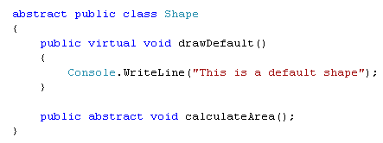
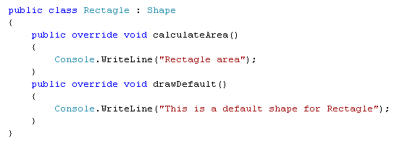
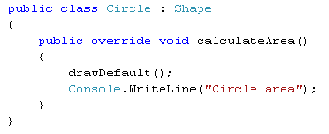
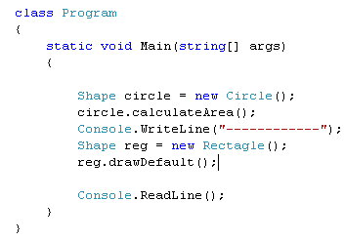
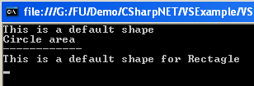
Polymorphism Implementation in C#
virtual : provide a default implementation. Can be overridden if necessary
abstract: sub-classes MUST override
Optional
Must
??
Besides virtual and abstract, C# provide new
keyword that applies to methods. What does
that mean?

Slide 47
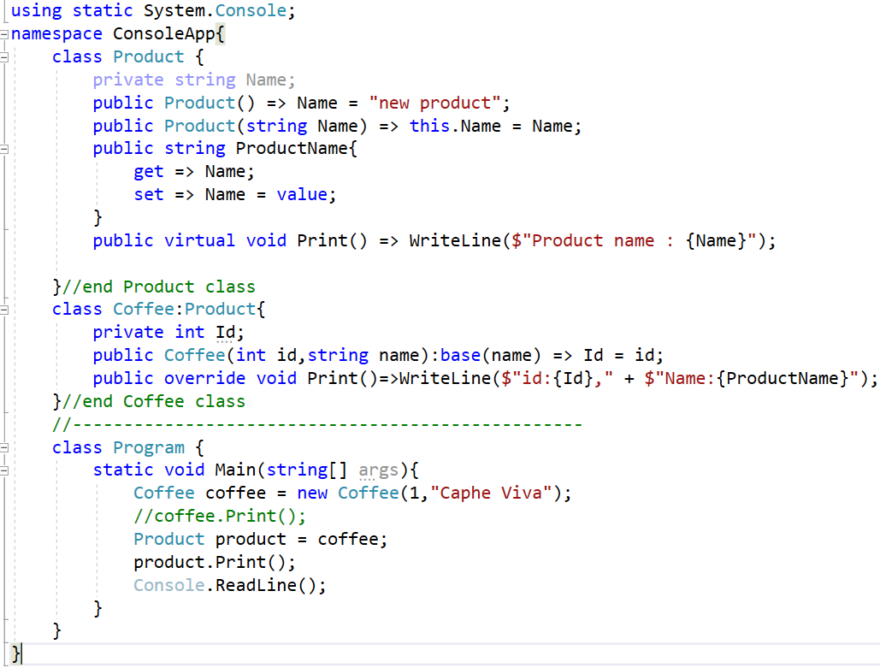

Slide 48
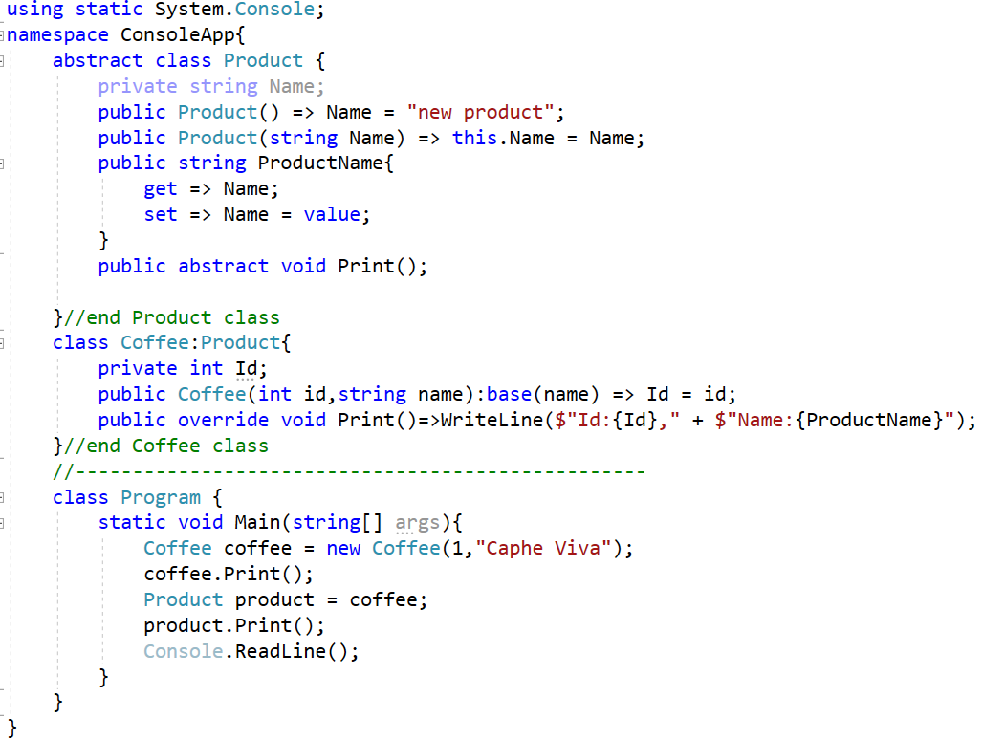

Slide 49



C# Casting Rules
Value type: conversion and casting
Convert smaller type to bigger type: OK (also called implicit cast)
Convert bigger type to smaller type: NOT OK => need an explicit cast => may cause loss of data
Lost data
Reference type: conversion and casting
Convert sub-class to supper class: OK (also called implicit cast)
Convert supper class to sub-class: NOT OK => need an explicit cast => may cause run time error

Slide 50

Determining the “Type of”
casting

Slide 51



C# Partial Types
Same class name

Slide 52
Chapter 4: Summary
Encapsulation
Inheritance
Polymorphism: virtual vs abstract
Casting rules:
Value types:
Convert smaller type to bigger type: OK (also called implicit cast)
Convert bigger type to smaller type: NOT OK => need an explicit cast => may cause loss of data
Reference type
Convert sub-class to supper class: OK (also called implicit cast)
Convert supper class to sub-class: NOT OK => need an explicit cast => may cause run time error

Slide 53


Chapter 4: Q & A

Slide 54
C# & .NET Framework
Chapter 5: Object Lifetime

Slide 55
Chapter 5: Objectives
Classes, Objects, and References
The Basics of Object Lifetime
The Role of Application Roots
Understanding Object Generations.

Slide 56
Classes, Objects, and References
No garbage collector in stack
Garbage collector is performed here

Slide 57


Object Lifetime
The new instruction informs the CLR to perform the following core tasks
Calculate the total amount of memory required for the object to be allocated
Examine the managed heap to ensure that there is indeed enough room to host the object to be allocated
Finally, before returning the reference to the caller, advance the next object pointer to point to the next available slot on the managed heap

Slide 58
The Role of Application Roots
A root is a storage location containing a reference to an object on the heap.
A root can fall into any of the following categories:
References to global objects
References to currently used static objects/static fields
References to local objects within a given method
References to object parameters passed into a method
References to objects waiting to be finalized

Slide 59


The Role of Application Roots
A clean and compacted heap
Object graphs are constructed to determine which objects are reachable by application roots.

Slide 60
Object Generations
To help optimize the process, each object on the heap is assigned to a specific “generation.”
The idea behind generations is simple: The longer an object has existed on the heap, the more likely it is to stay there.
Generation 0: Identifies a newly allocated object that has never been marked for collection
Generation 1: Identifies an object that has survived a garbage collection (i.e., it was marked for collection, but was not removed due to the fact that the sufficient heap space was acquired)
Generation 2: Identifies an object that has survived more than one sweep of the garbage collector

Slide 61

Object Generations
The garbage collector will investigate all generation 0 objects first. If marking and sweeping these objects results in the required amount of free memory, any surviving objects are promoted to generation 1.
If all generation 0 objects have been evaluated, but additional memory is still required, generation 1 objects are then investigated for their “reachability” and collected accordingly. Surviving generation 1 objects are then promoted to generation 2.
If the garbage collector still requires additional memory, generation 2 objects are then evaluated for their reachability.
Generation 0 objects that survive a garbage collection are promoted to generation 1.

Slide 62
Chapter 5: Summary
Object graphs are constructed to determine which objects are reachable by application roots.
To help optimize the process, each object on the heap is assigned to a specific “generation.”
Generation 0: Identifies a newly allocated object that has never been marked for collection
Generation 1: Identifies an object that has survived a garbage collection (i.e., it was marked for collection, but was not removed due to the fact that the sufficient heap space was acquired)
Generation 2: Identifies an object that has survived more than one sweep of the garbage collector

Slide 63
Chapter 5: Q & A

Slide 64
C# & .NET Framework
Chapter 6: Exception Handling

Slide 65
Chapter 6: Objectives
Errors, Bugs, Exceptions
Catching Exception: try – catch – finally
Exception Propagation

Slide 66
Errors, Bugs, and Exceptions
Bugs: an error on the part of the programmer.
For example, making calls on a NULL pointer
User errors: typically caused by the individual running the application
For example, an end user who enters a malformed string into a text box
Exceptions: run time error and beyond the control of the program

Slide 67


Errors, Bugs, and Exceptions
When an exception occurs, the program will terminate abruptly
Example
Exception message
Exception details

Slide 68
Catching exceptions: try – catch – finally
try
try block
{
< statements may cause exceptions >
}
e?
false
catch ( ExceptionType1 e1 )
true
{
< statements handle the situation 1>
}
catch block
catch ( ExceptionType2 e2)
{
< statements handle the situation 2>
}
finally block
finally
{
< statements are always executed >
}

Slide 69


Exception handling example

Slide 70

Exception Propagation
Stack for A()
catch(...)
A()
Stack for B()
B()
Stack for C()
Stack for D()
C()
Stack trace
D()
Exception

Slide 71


Exception handling : stacktrace example

Slide 72
Chapter 6: Summary
Errors, Bugs, Exceptions
Catching Exception: try – catch – finally
Exception Propagation
try
try block
{
< statements may cause exceptions >
}
e?
false
catch ( ExceptionType1 e1 )
true
{
< statements handle the situation 1>
}
catch block
catch ( ExceptionType2 e2)
{
< statements handle the situation 2>
}
finally block
finally
{
< statements are always executed >
}

Slide 73
Chapter 6: Q & A

